Slide 1


Slide 2

VITB-JHU HEALTH HACKATHON 2025
Problem Statement Title: AI-Enabled Early Symptom Detection for Common Health Conditions
Theme: Digital Health & Accessibility -
Category: Software -
Team Name: Nameless Guild
University Name: VIT Bhopal University

Slide 3
Agenda
1
2
3
4
5
Technical solutions
Implementations
And benefits
Problem statement
Primary solutions
Non-AI aspects

Slide 4

PROBLEM STATEMENT
INFRASTRUCTURE DEFICIENCIES
TECHNICAL AND EQUIPEMENTS ISSUES
HUMAN RESOURCE SHORTAGES
HIGH COSTS , LIMITED BUDGET
CULTURAL AND SOCIAL CHALLENGES

Slide 5
PROPOSED SOLUTION
Hybrid Platform: Combines AI-powered visual analysis with manual symptom logging
Empowers users: Suggests next steps, provides education, and locates nearby clinics.
Bridge to care : not a diagnosis tool , supports , guides , cares

Slide 6
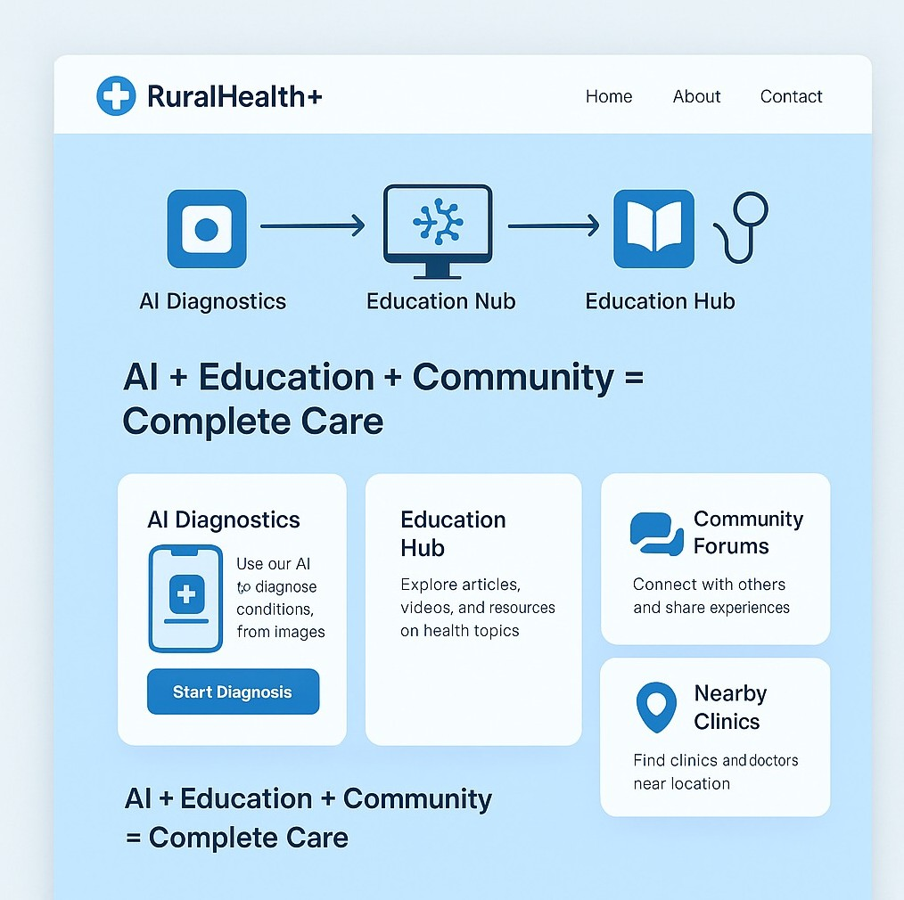
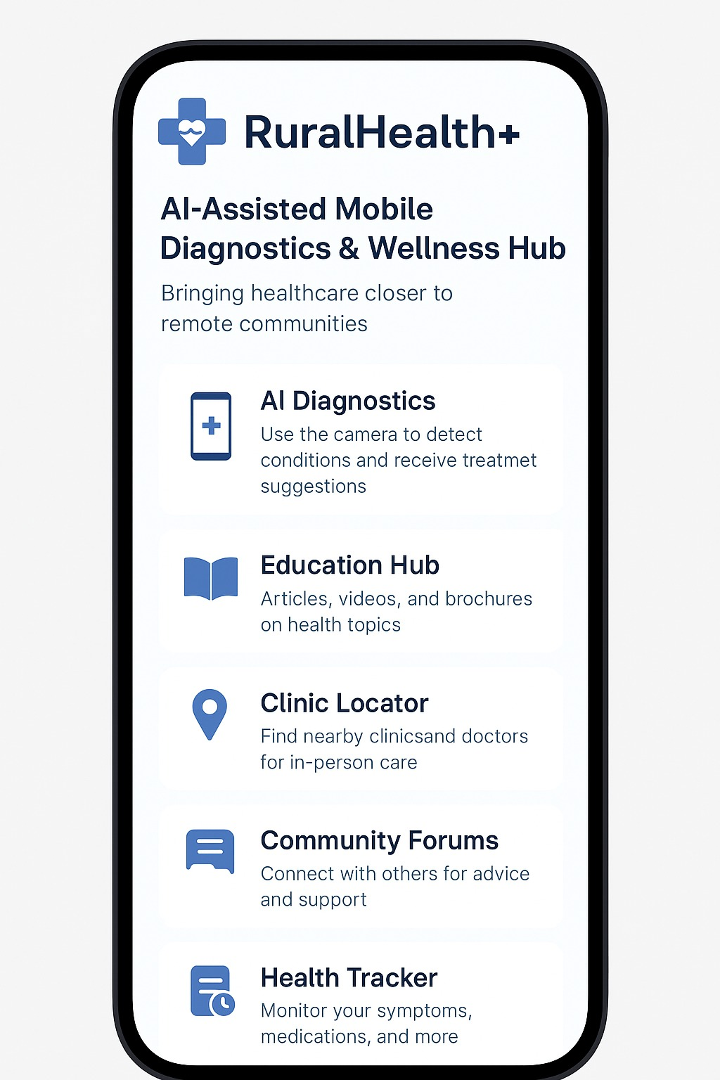

Slide 7
TECHNICAL STRATEGIES
Frontend: HTML , CSS , JAVA script
Backend: Django , Python
AI : scikit learn , tensor flow
Database: SQL ,Mongo DB
Maps API: Google Maps

Slide 8
NON-AI ASPECTS OF OUR MODEL
EDUCATION CONTENT HUB
NEARBY CLINIC AND DOCTOR LOCATORS
HEALTH TRACKER AND REMINDER TOOLS
EMERGENCY AND HELPLINE ACCESS

Slide 9
Feasibility:
Uses common smartphones (no new hardware).
Modular design (AI + Web + Offline).
Challenges:
Medical data reliability, language localization.
Solutions:
Continuous model retraining, regional partnerships.
Community verification of clinic data
FEESIBILITY AND IMPLEMENTATIONS

Slide 10

IMPACTS AND BENEFITS
ENHANCED ACCESSEBILITY
COST EFFECTIVENESS
EARLY DISEASE DETECTION
SIGNIFICANT TIME SAVING
BETTER HEALTH OUTCOMES

Slide 11
REFERENCES
WHO Mobile Health Guidelines (2023)
Johns Hopkins Med Hacks Case Studies (2024)
VIT–JHU Health Hack Problem Statements (2025)
NIH Image Datasets (2022–2024)
TensorFlow Lite Documentation
Government of India Health Mission Reports

Slide 12
Thank you
We believe SafeStart Health is more than just a product — it's a step toward empowering communities with early awareness, accessible guidance, and a bridge to better care.
Together, let's reimagine how health begins — with comfort, clarity, and confidence.
— Team Nameless Guild
SHALINI PAL , PAUSUAN TONSING ,DEVANSH DUBEY , SUDISH AGGARWAL , BEDANTIKA BANERJEE , AKANKSHA CHANDA

